Slide 1
A Quant Model with Multiple Signals
Combine multiple signals to build a quant model
Aggregate scores based on individual signals (JPM Q-Score approach)
Regressions
Regression Trees
Random Forest
XGBoost
LLMs

Slide 2
Aggregate Scores (e.g. JPM Q-model)
Assign ranks based on signals
Rank signals and assign scores so that high scores imply bigger returns
Add scores and pick stocks with the biggest total scores

Slide 3
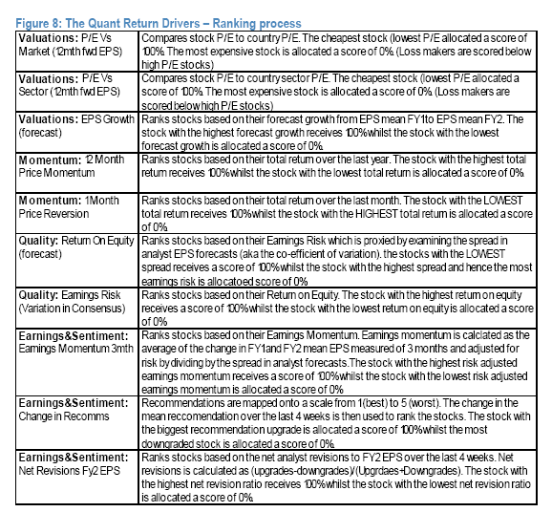

Slide 4
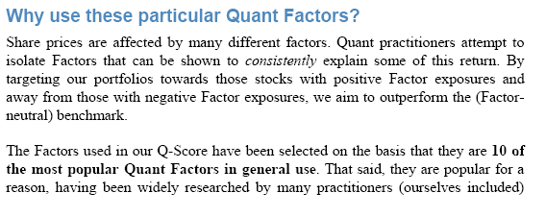
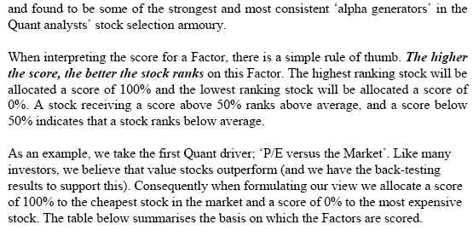

Slide 5
Signals
b2m: Book to market
CashFlow2TA: Cash flow from operations (oancf)/ Total Assets (AT)

Slide 6
IBM Income Statement

Slide 7
Cash Flow Statement

Slide 8
Net income Vs Cash flows
$5,743 Vs. $12,796
What explains the difference?
Accrual Accounting: Revenues and expenses are recorded based on completion of sales and not based on cash flows associated with operations, e.g.
Inventory
Accounts Receivables
Accounts Payable
A signals should be comparable across stocks. Is cash flow from operations comparable across stock?
Standardize

Slide 11
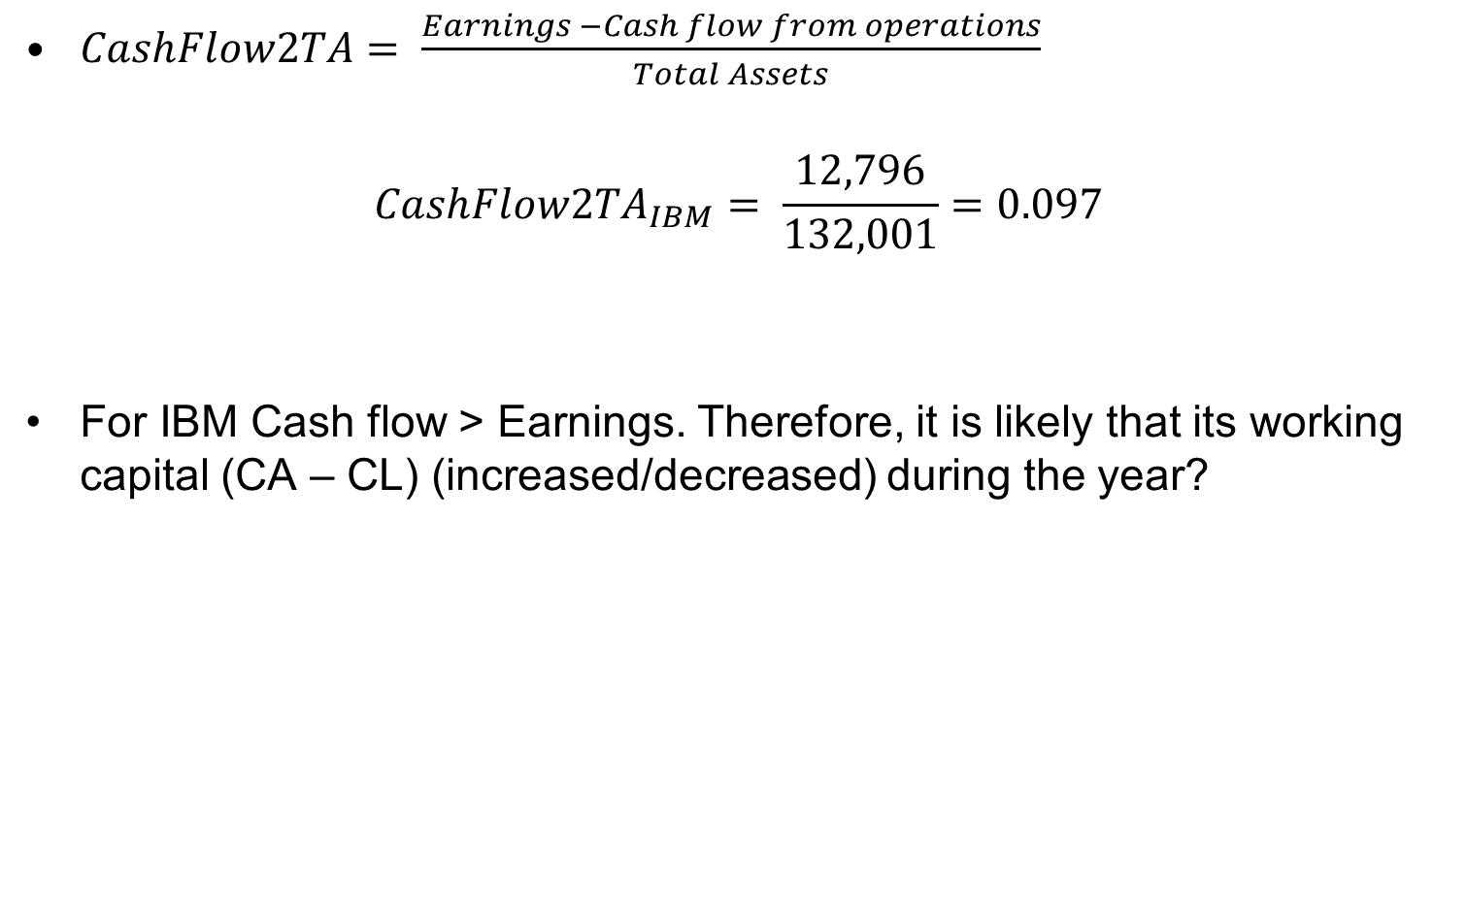
Cash Flow scaled by assets
$CashFlow2TA= \frac{Earnings −Cash flow from operations}{Total Assets}$
$$CashFlow2TA_{IBM}= \frac{12,796}{132,001}=0.097$$
For IBM Cash flow > Earnings. Therefore, it is likely that its working capital (CA – CL) (increased/decreased) during the year?

Slide 12
Combining Signals
Compute percentile scores based on each signal
Percentile score more granular than decile rank
merged_data['b2m_pct_rank']= merged_data.groupby(['year','month'])['b2m'].rank(pct = True)
merged_data['CashFlow2TA_rank']= merged_data.groupby(['year','month'])['CashFlow2TA'].rank(pct = True)
merged_data['combined_rank'] = merged_data['b2m_pct_rank'] + merged_data['CashFlow2TA_rank']
How would you assign scores if a bigger feature predicts smaller returns?
Evaluate trading strategy based on combined rank

Slide 13
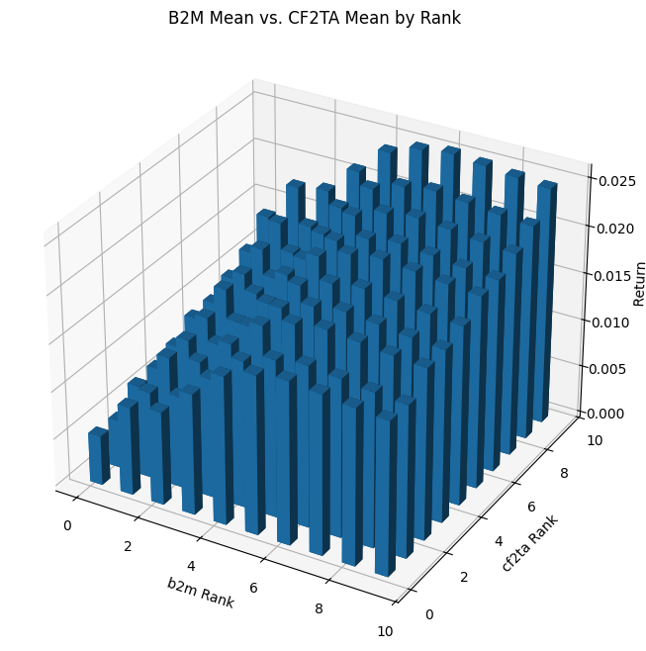

Slide 14
Regression Models
A regression model to combine multiple signals and build a quant model
Model
Handling outliers
Computing t-statistics to test for significance
Pros and cons

Slide 15
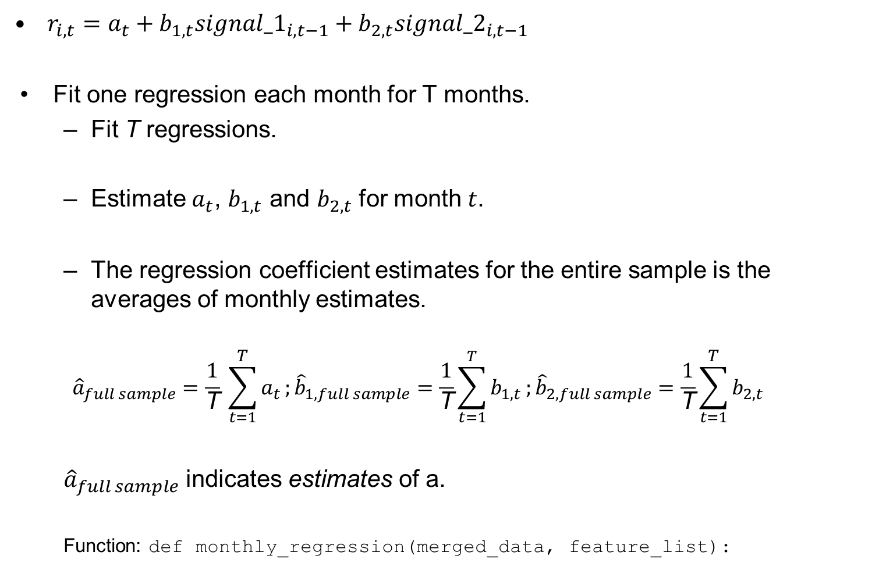
Model
$r_{i,t}=a_{t}+b_{1,t}{signal_1}_{i,t−1}+b_{2,t}{signal_2}_{i,t−1}$
Fit one regression each month for T months.
Fit T regressions.
Estimate $a_{t}$, $b_{1,t}$ and $b_{2,t}$ for month $t$.
The regression coefficient estimates for the entire sample is the averages of monthly estimates.
$${\hat{a}}_{full sample}=\frac{1}{\text{T}} \sum_{t=1}^{T}{a_{t}};{\hat{b}}_{1,full sample}=\frac{1}{\text{T}}\sum_{t=1}^{T}{b_{1,t}};{\hat{b}}_{2,full sample}=\frac{1}{\text{T}}\sum_{t=1}^{T}{b_{2,t}}$$
${\hat{a}}_{full sample}$ indicates estimates of a.
Function: def monthly_regression(merged_data, feature_list):

Slide 16
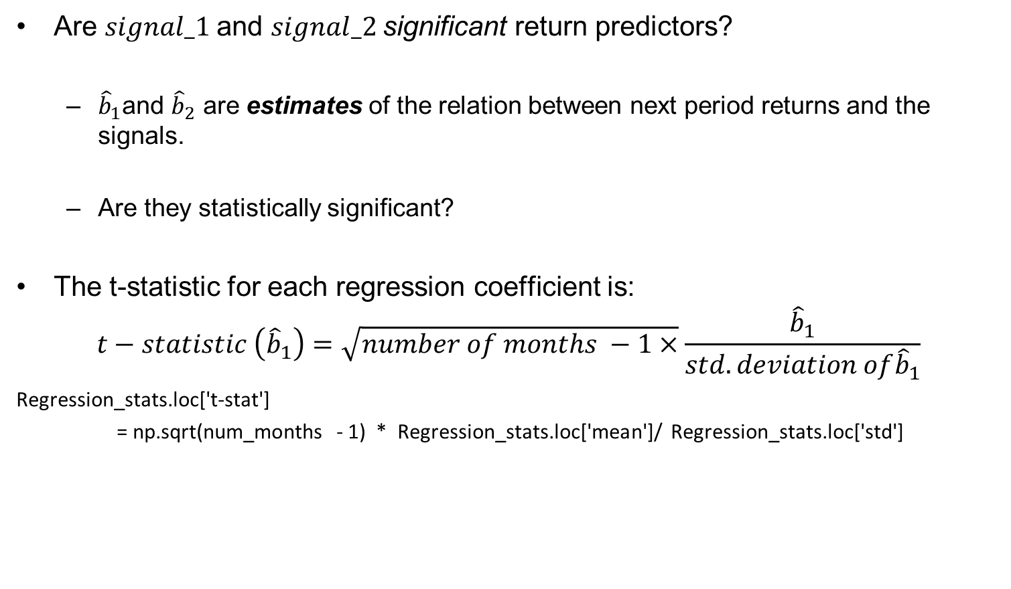
Statistical significance: Computing t-statistics
Are $signal_1$and $signal_2$significant return predictors?
${\hat{b}}_{1}$and ${\hat{b}}_{2}$ are estimates of the relation between next period returns and the signals.
Are they statistically significant?
The t-statistic for each regression coefficient is:
$$t−statistic \left({\hat{b}}_{1}\right)=\sqrt{number of months −1×}\frac{{\hat{b}}_{1}}{std.deviation of{\hat{b}}_{1}}$$
Regression_stats.loc['t-stat']
= np.sqrt(num_months - 1) * Regression_stats.loc['mean']/ Regression_stats.loc['std']

Slide 17
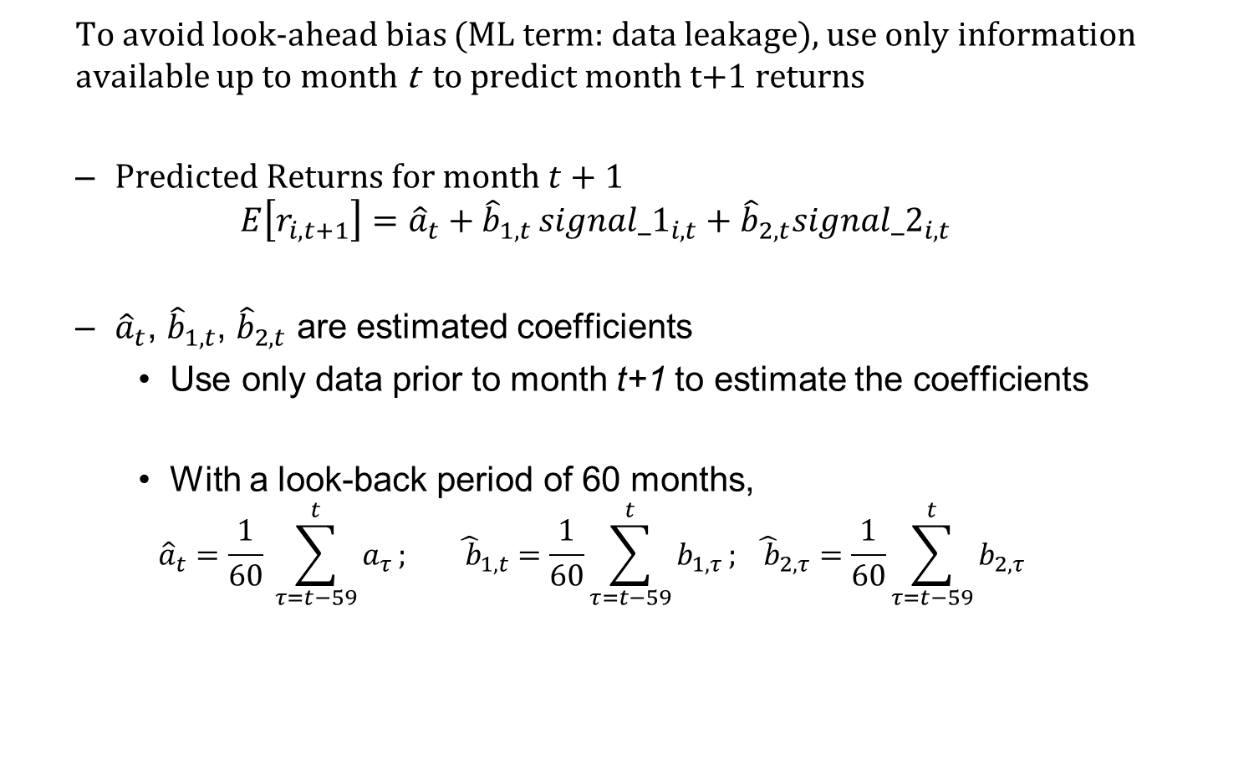
Return Prediction
To avoid look-ahead bias (ML term: data leakage), use only information available up to month t to predict month t+1 returns
$Predicted Returns for month t+1$
$$E\left[r_{i,t+1}\right]={\hat{a}}_{t}+{\hat{b}}_{1,t }{signal_1}_{i,t}+{\hat{b}}_{2,t}{signal_2}_{i,t}$$
${\hat{a}}_{t}$, ${\hat{b}}_{1,t}$, ${\hat{b}}_{2,t}$ are estimated coefficients
Use only data prior to month t+1 to estimate the coefficients
With a look-back period of 60 months,
$${\hat{a}}_{t}=\frac{1}{60} \sum_{τ=t−59}^{t}{a_{τ}};{ \hat{ b}}_{1,t }=\frac{1}{60}\sum_{τ=t−59}^{t}{b_{1,τ}}; {\hat{ b}}_{2,τ}=\frac{1}{60}\sum_{τ=t−59}^{t}{b_{2,τ}}$$

Slide 18
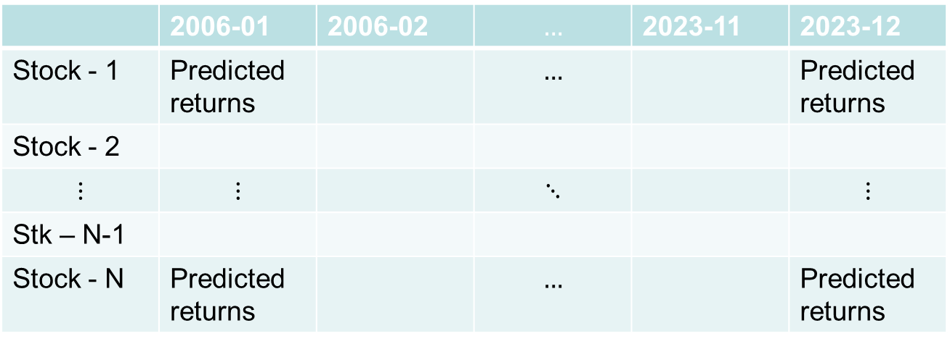
Predicted return
Return prediction is from (first month+60), to last month
Function: def rolling_window_prediction(monthly_regression_dataframe, reg_factor_list, rolling_window = 60) :
Trading strategy performance evaluation
Function: def portfolio_returns_statistics(predicted_ret_df):
 | 2006-01 | 2006-02 | $$…$$ | 2023-11 | 2023-12
Stock - 1 | Predicted returns |  | $$…$$ |  | Predicted returns
Stock - 2
$$⋮$$ | $$⋮$$ |  | $$⋱$$ |  | $$⋮$$
Stk – N-1
Stock - N | Predicted returns |  | $$…$$ |  | Predicted returns

Slide 19
Signal outliers
Are outliers likely to be an issue with b2m?
How do you handle outliers?

Slide 20
Pros and cons
Pros
Easy to execute
Allows for multiple signals
Each signal’s weight reflects the strength of its relation with returns
Cons
Fits a linear relation between signals and returns while a non-linear model may fit better
Does not capture interactions between signals
High correlations among signals could lead to low precision of regression estimates

